Slide 1
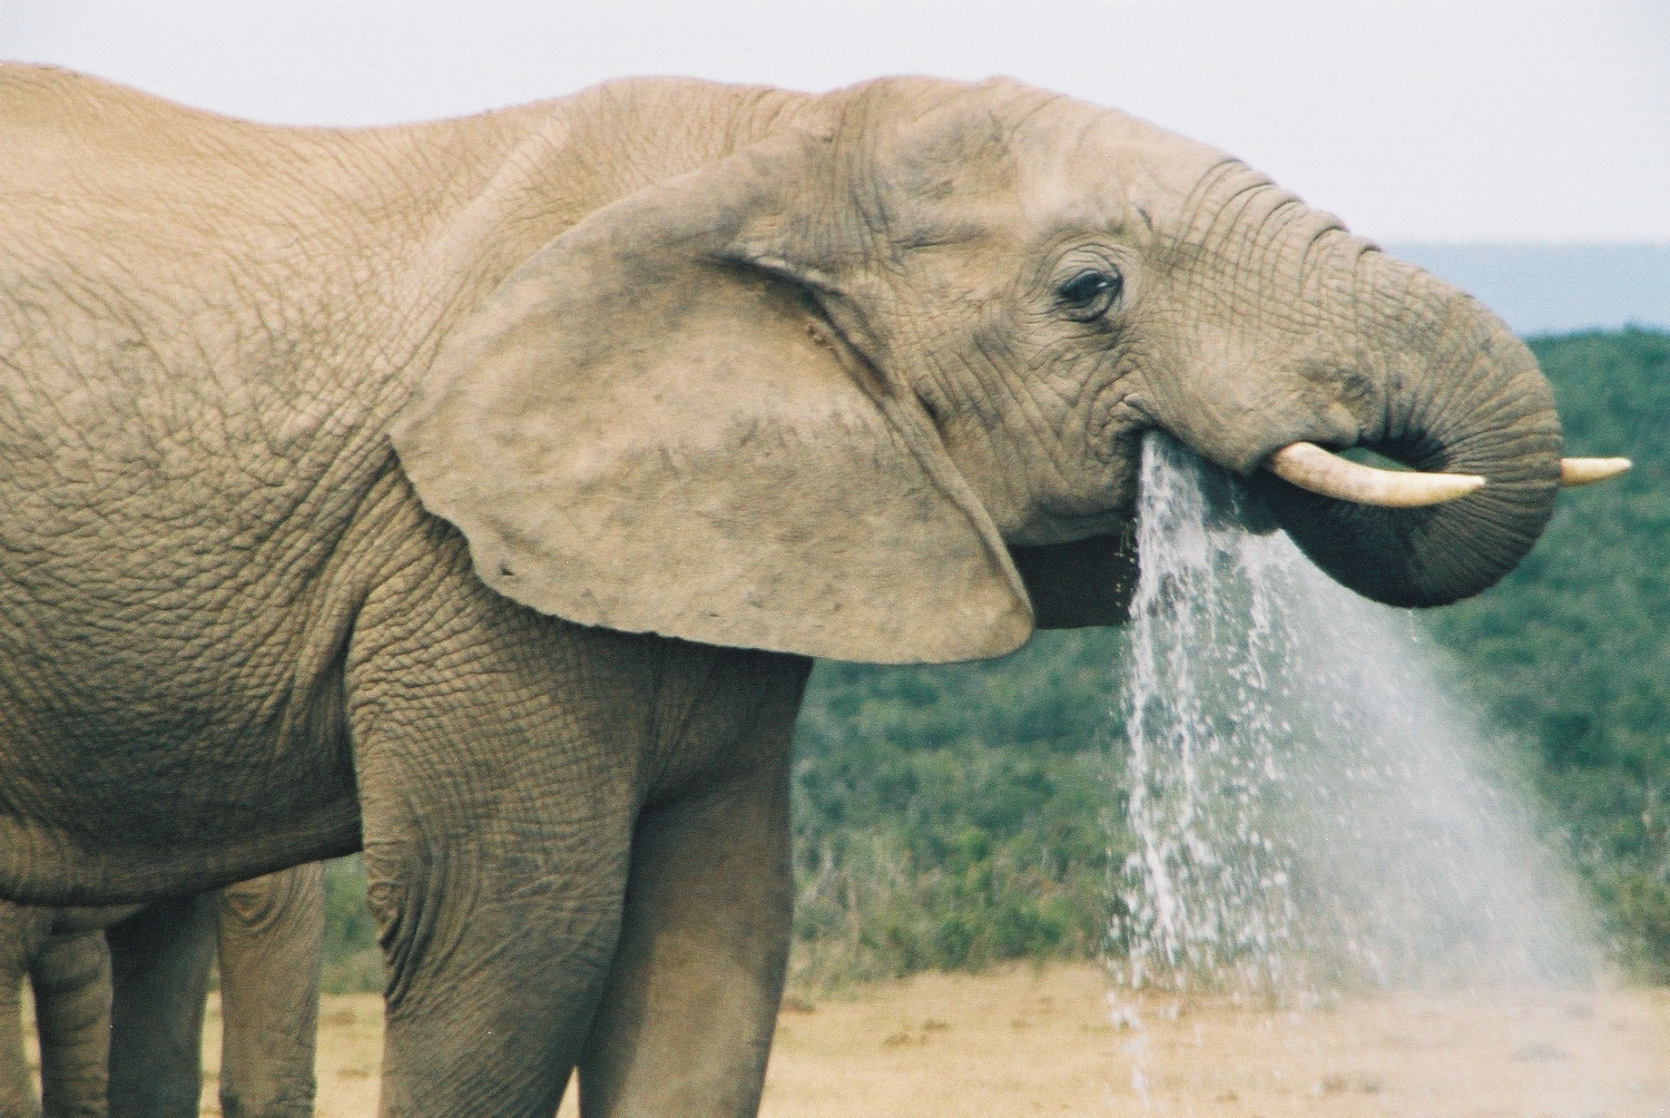
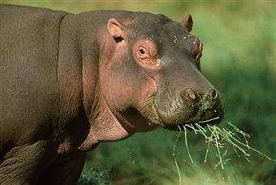
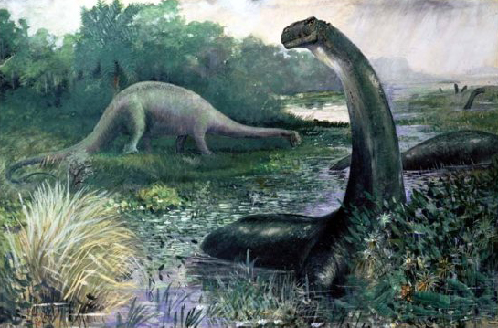
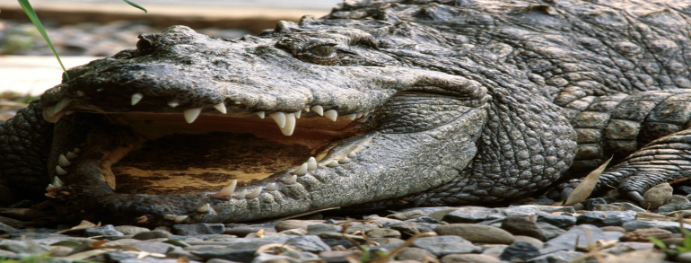

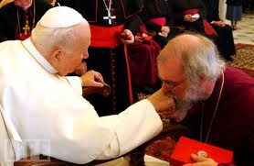
Natural
WISDOM vs
Spiritual
Gold-
Corrupt
Bibles
December 30, 2012 to Jan 2013

Slide 2
God’s Word has both a true literal meaning and a spiritual testimony. All persons can see the true literal meaning. The natural person with a natural mind can choose to believe the incorruptible testimony of Jesus Christ and repent. When the holy Ghost is sent to a person, he will testify of Jesus Christ on a spiritual level that the unsaved world cannot see. A person is spiritually blind until Jesus Christ removes the scales from their eyes.
Satan has been leading the Church of Babylon and has corrupted God’s Word, cast doubt on the truth, and with great subtlety, made seemingly minor changes which has completely destroyed the spiritual testimony and has kept the earth blind and unsaved. Satan teaches men his corrupted Word. See Ezekiel 28

Slide 3
Malachi 3:6 For I am the Lord, I change not: …
Romans 3:4 God forbid: yea, let God be true, but euery man a lier,
Rev 22:18 For I testifie vnto euery man that heareth the wordes of the prophesie of this booke, If any man shal adde vnto these things, God shall adde vnto him the plagues, that are written in this booke. 19And if any man shall take away from the wordes of the booke of this prophesie, God shal take away his part out of the booke of life, and out of the holy citie, and from the things which are written in this booke.
Proverbs 30:6 Adde thou not vnto his words, lest he reproue thee, and thou be found a lyar.
Deuteronony 4:2 Ye shall not adde vnto the word which I command you, neither shall you diminish ought from it, that ye may keepe the Commaundements of the Lord your God, which I command you.

Slide 4
The corrupt dumb idols of Babylon (NIV, NKJV, NAB, NAS, ESV, ASV, RSV, DR, NLT, etc.) are reproved by the holy Ghost as molten images of God made by men in accordance to their own understanding (see Hosea 13:2.) These idols keep people in a natural unsaved state. In addition, Leviathan has decreed his apologetics in Blayney KJV’s and has provided Lexicon’s to match his lamps which proceed of out his mouth (Job 41:19.) Satan emphasizes the natural literal interpretations of scripture and is working continually to correct and clarify the Word since natural men are confounded.

Slide 5
Thus saith the Lord:
1 Cor 2:13 Which things also we speake, not in the words which mans wisedome teacheth, but which the holy Ghost teacheth, comparing spiritual things with spirituall.
Mat 13:13 Therefore speake I to them in parables: because they seeing, see not: and hearing, they heare not, neither doe they vnderstand.
1 Cor 2:14 But the naturall man receiueth not the things of the Spirit of God, for they are foolishnesse vnto him: neither can he know them, because they are spiritually discerned.

Slide 6
Thus saith the Lord:
1 John 2:27 But the anointing which ye haue receiued of him, abideth in you: and yee need not that any man teach you: But, as the same anointing teacheth you of all things, and is trueth, and is no lye: and euen as it hath taught you, ye shall abide in him.
John 14:26 But the Comforter, which is the holy Ghost, whom the Father wil send in my name, he shal teach you al things, & bring al things to your remembrance, whatsoeuer I haue said vnto you
1 Cor 12:3 Wherefore I giue you to vnderstand, that no man speaking by the spirit of God, calleth Iesus accursed: and that no man can say that Iesus is the Lord, but by the holy Ghost.

Slide 7
Let’s read the following slides as a natural person would and discuss. Then let’s read it as a saint/spiritual person. Let us discuss any differences. Is it easier to reprove naturally or spiritually? We will examine only one problem on each slide (though there are usually many) that the holy Ghost cites.

Slide 8
AV1611 1 John 4:3 And euery Spirit that confesseth not that Iesus Christ is come in the flesh, is not of God: and this is that spirit of Antichrist, whereof you haue heard, that it should come, and euen now already is it in the world.
NAB 1 John 4:3 and every spirit that does not acknowledge Jesus* does not belong to God. This is the spirit of the antichrist that, as you heard, is to come, but in fact is already in the world.^{c}
NIV 1 John 4:3 but every spirit that does not acknowledge Jesus is not from God. This is the spirit of the antichrist, which you have heard is coming and even now is already in the world.

Slide 9
What the holy Ghost taught me:
The Babylonian bibles do not confess that Jesus Christ is come in the flesh, therefore, they are of the spirit of antichrist.
Do devils acknowledge Jesus? Do devils confess Jesus?
Acts 19:15 And the euill spirit answered, and said, Iesus I knowe, and Paul I know, but who are ye?
Mark 5:7 And cried with a lowd voice, and said, What haue I to doe with thee, Iesus, thou Sonne of the most high God? I adiure thee by God, that thou torment me not.

Slide 10
AV1611 James 5:1 Goe to now, yee rich men, weepe and howle for your miseries that shall come vpon you. 2 Your riches are corrupted, and your garments motheaten: 3 Your gold and siluer is cankered, and the rust of them shall bee a witnesse against you, and shall eate your flesh as it were fire: ye haue heaped treasure together for the last dayes.
NAB James 5:1 Come now, you rich, weep and wail over your impending miseries.ª 2Your wealth has rotted away, your clothes have become moth-eaten,^{b} 3your gold and silver have corroded, and that corrosion will be a testimony against you; it will devour your flesh like a fire. You have stored up treasure for the last days.^{c}
NIV James 5:1 Now listen, you rich people, weep and wail because of the misery that is coming on you. ² Your wealth has rotted, and moths have eaten your clothes. ³ Your gold and silver are corroded. Their corrosion will testify against you and eat your flesh like fire. You have hoarded wealth in the last days.

Slide 11
What the holy Ghost taught me:
The wisdom (Gold) and understanding (silver) of the unsaved men in James 5 has rust because it has been corrupted. Babylon changes rust to corrosion to please the literal meaning while destroying the spiritual lesson.
Job 28:2 Iron is taken out of the earth, and brasse is molten out of the stone.
Jer 6:28 They are all grieuous reuolters, walking with slanders: they are brasse and yron, they are all corrupters.
Proverbs 16:16 How much better is it to get wisedome, then gold? and to get vnderstanding, rather to be chosen then siluer?

Slide 12
AV1611 Rev 8:10 And the third Angel sounded, and there fell a great starre from heauen, burning as it were a lampe, and it fell vpon the third part of the riuers, and vpon the fountaines of waters:
NAB Rev 8:10 When the third angel blew his trumpet, a large star burning like a torch fell from the sky. It fell on a third of the rivers and on the springs of water.^{g}
NIV Rev 8:10 The third angel sounded his trumpet, and a great star, blazing like a torch, fell from the sky on a third of the rivers and on the springs of water—

Slide 13
What the holy Ghost taught me:
The abomination of Desolation is revealed as Solomon’s book of Wisdom throughout the AV1611. God teaches us that a lamp represents the Word (either corrupted or incorruptible.) Changing from lamp to torch may please the natural mind but hides the prophecy of Wormwood, Solomon’s book of Wisdom.
Psalm 119:105 Thy word is a lampe vnto my feete: and a light vnto my path.

Slide 14
AV1611 2 Cor 2:17 For wee are not as many which corrupt the word of God: but as of sinceritie, but as of God, in the sight of God speake we in Christ.
NAB 2 Cor 2:17 For we are not like the many who trade on the word of God; but as out of sincerity, indeed as from God and in the presence of God, we speak in Christ.^{g}
NIV 2 Cor 2:17 Unlike so many, we do not peddle the word of God for profit. On the contrary, in Christ we speak before God with sincerity, as those sent from God.

Slide 15
What the holy Ghost taught me:
God says many corrupt his Word and Babylon refuses to acknowledge this. Rather, Babylon denies that their trafficking of God’s corrupted abominations is rooted in their church according to God. They say “we do not trade on the Word of God, God says they corrupt his word and overspread their bible abominations throughout the earth.
Rev 18:23 And the light of a candle shall shine no more at all in thee: and the voice of the bridegrome and of the bride shalbe heard no more at all in thee: for thy Merchants were the great men of the earth: for by thy sorceries were all nations deceiued.

Slide 16
AV1611 Isaiah 14:12 How art thou fallen from heauen, O Lucifer, sonne of the morning? how art thou cut downe to the ground, which didst weaken the nations?
NAB Isaiah 14:12 How you have fallen from the heavens,
O Morning Star,* son of the dawn! How you have been cut down to the earth, you who conquered nations!^{i}
NIV Isaiah 14:12 How you have fallen from heaven, morning star, son of the dawn! You have been cast down to the earth, you who once laid low the nations!

Slide 17
What the holy Ghost taught me:
Babylonian copyrighted scripture confesses Satan as God.
Rev 22:16 I Iesus haue sent mine Angel, to testifie vnto you these things in the Churches. I am the roote and the offspring of Dauid, and the bright and morning starre.
Isaiah 14:14 I wil ascend aboue the heights of the cloudes, I wil bee like the most High.

Slide 18
AV1611 Isaiah 30:22 Ye shall defile also the couering of thy grauen images of siluer, and the ornament of thy moulten images of gold: thou shalt cast them away as a menstruous cloth, thou shalt say vnto it; Get thee hence.
NAB Isaiah 30:22 You shall defile your silver-plated idols
and your gold-covered images; You shall throw them away like filthy rags, you shall say, “Get out!”^{s}
NIV Isaiah 30:22 Then you will desecrate your idols overlaid with silver and your images covered with gold; you will throw them away like a menstrual cloth and say to them, “Away with you!”

Slide 19
AV1611 Jeremiah 51:17 Euery man is brutish by his knowledge: euery founder is confounded by the grauen image: for his moulten image is falsehood, and there is no breath in them.
NAB Jeremiah 51:17 Every man is stupid, ignorant;
every artisan is put to shame by his idol: He molds a fraud,
without life-breath.
NIV Jeremiah 51:17 “Everyone is senseless and without knowledge; every goldsmith is shamed by his idols.
The images he makes are a fraud; they have no breath in them.

Slide 20
AV1611 1 Peter 2:6 Wherefore it is conteined in the Scripture, Beholde, I lay in Sion a chiefe corner stone, elect, precious, and he that beleeueth on him, shall not be confounded.
NAB 1 Peter 2:6 For it says in scripture: “Behold, I am laying a stone in Zion, a cornerstone, chosen and precious,
and whoever believes in it shall not be put to shame.”^{e}
NIV 1 Peter 2:6 For in Scripture it says:“See, I lay a stone in Zion, a chosen and precious cornerstone, and the one who trusts in him will never be put to shame.

Slide 21
What the holy Ghost taught me:
If you corrupt God’s Word (Molten Image) you will be confounded and not saved. Babylon hides this by changing the words.
John 3:16 For God so loued ye world, that he gaue his only begotten Sonne: that whosoeuer beleeueth in him, should not perish, but haue euerlasting life.
1 Peter 2:6 Wherefore it is conteined in the Scripture, Beholde, I lay in Sion a chiefe corner stone, elect, precious, and he that beleeueth on him, shall not be confounded.

Slide 22
AV1611 Zech 5:3 Then said hee vnto mee; This is the curse, that goeth forth ouer the face of the whole earth: for euery one that stealeth shall be cut off as on this side, according to it; and euery one that sweareth shall be cut off as on that side, according to it.
NAB Zech 5:3 Then he said to me: “This is the curse which is to go forth over the whole land. According to it, every thief and every perjurer* will be expelled.
NIV Zech 5:3 And he said to me, “This is the curse that is going out over the whole land; for according to what it says on one side, every thief will be banished, and according to what it says on the other, everyone who swears falsely will be banished.

Slide 23
What the holy Ghost taught me:
God is describing wormwood, the curse of the earth known as Solomon’s book of wisdom. The two-edged sword cuts off people on each side. Babylon changes the words to hide the sword (book of wisdom.)
Proverbs 5:4But her end is bitter as wormewood, sharpe as a two edged sword.
Rev 1:16 And hee had in his right hand seuen starres: and out of his mouth went a sharpe two edged sword: and his countenance was as the Sunne shineth in his strength.

Slide 24
AV1611 Rev 19:8 And to her was granted, that she should bee arayed in fine linnen, cleane and white: for the fine linnen is the righteousnesse of Saints.
NAB Rev 19:8 She was allowed to wear
a bright, clean linen garment.”^{e}(The linen represents the righteous deeds of the holy ones.)*
NIV Rev 19:8 Fine linen, bright and clean,
was given her to wear.” (Fine linen stands for the righteous acts of God’s holy people.)

Slide 25
What the holy Ghost taught me:
We are washed by the blood of the lamb and our faith in Jesus Christ. We are not washed by our own deeds.
Titus 3:5 Not by workes of righteousnesse which wee haue done, but according to his mercy he saued vs, by the washing of regeneration, and renewing of the holy Ghost,
Rev 12:11 And they ouercame him by the blood of the Lambe, and by the word of their Testimony, and they loued not their liues vnto the death.
Isaiah 64:6 But we are al as an vncleane thing, and all our righteousnesses are as filthy ragges, and we all doe fade as a leafe, and our iniquities like the wind haue taken vs away.

Slide 26
AV1611 Job 41:2 Canst thou put an hooke into his nose? or bore his iawe through with a thorne?
NAB Job 40:26/41:2 Can you put a ring into his nose, or pierce through his cheek with a gaff?
NIV Job 41:2 Can you put a cord through its nose
or pierce its jaw with a hook?

Slide 27
What the holy Ghost taught me:
The antichrist gets a hook in his nose in at least two places in scripture. His jaw is bored through with a thorn in at least three places too.
2 Kings 19:28 Because thy rage against me, and thy tumult is come vp into mine eares, therefore I will put my hooke in thy nose, and my bridle in thy lips, and I will turne thee backe by the way by which thou camest.

Slide 28
AV1611 Song of Solomon 2:5-7 Stay me with flagons, comfort me with apples, for I am sicke of loue. 6 His left hand is vnder my head, and his right hand doeth imbrace me. 7 I charge you, O ye daughters of Ierusalem, by the Roes, and by the hindes of the field, that ye stirre not vp, nor awake my loue, till she please.
NAB Song of Songs 2:5-7
5^{b} Strengthen me with raisin cakes,*refresh me with apples,
for I am sick with love. 6^{c} His left hand is under my head
and his right arm embraces me. 7^{d} I adjure you, Daughters of Jerusalem,*by the gazelles and the does of the field, Do not awaken, or stir up love until it is ready.
NIV Song of Songs 2:5-7
5 Strengthen me with raisins, refresh me with apples, for I am faint with love.
⁶ His left arm is under my head, and his right arm embraces me.
⁷ Daughters of Jerusalem, I charge you by the gazelles and by the does of the field: Do not arouse or awaken love until it so desires.

Slide 29
What the holy Ghost taught me:
The Queen of the South is drunk on wine in the arms of the final antichrist. Word changes hide the entire meaning and prophecy.
Hos 3:1 Then said the Lord vnto me, Goe yet, loue a woman (beloued of her friend, yet an adulteresse) according to the loue of the Lord toward the children of Israel, who looke to other gods, and loue flagons of wine.
Rev 18:3 For all nations haue drunke of the wine of the wrath of her fornication, and the Kings of the earth haue committed fornication with her, & the Merchants of the earth are waxed rich thorow the abundance of her delicacies.
Song of Solomon 5:1 I am come into my garden, my sister, my spouse, I haue gathered my Myrrhe with my spice, I haue eaten my honie combe with my hony, I haue drunke my wine with my milke: eate, O friends, drinke, yea drinke abundantly, O beloued!

Slide 30
AV1611 Ezekiel 21:2
Sonne of man, set thy face toward Ierusalem, and drop thy word toward the holy places, and prophecie against the land of Israel,
NAB Ezekiel 21:2
Son of man, turn your face to the south: preach against the south, prophesy against the forest land in the south.
NIV Ezekiel 21:2
“Son of man, set your face against Jerusalem and preach against the sanctuary. Prophesy against the land of Israel

Slide 31
What the holy Ghost taught me:
In God’s Word, prophets are clouds and they drop the rain of doctrine. Babylon hides this in their merchandise.
Deuteronomy 32:2 2 My doctrine shall drop as the raine: my speech shall distill as the deaw, as the smal raine vpon the tender herbe, and as the showres vpon the grasse.
2 Peter 2:16-17 16 But was rebuked for his iniquity: the dumbe asse speaking with mais voice, forbade the madnesse of the Prophet. 17These are welles without water, cloudes that are caried with a tempest, to whom the mist of darkenesse is reserued for euer.

Slide 32
AV1611 Revelation 13:16
And he causeth all, both smal and great rich and poore, free and bond, to receiue a marke in their right hand, or in their foreheads:
NAB Revelation 13:16
It forced all the people, small and great, rich and poor, free and slave, to be given a stamped image on their right hands or their foreheads,^{j}
NIV Revelation 13:16
It also forced all people, great and small, rich and poor, free and slave, to receive a mark on their right hands or on their foreheads,

Slide 33
What the holy Ghost taught me:
All will be beguiled into swearing an oath that Solomon’s book of wisdom is the Word of God. There will be no physical mark and it will be in the head or in the hand. Babylon changes words which kill prophecy.
James 5:12 But aboue all things, my brethren, sweare not, neither by heauen, neither by the earth, neither by any other othe: but let your yea, be yea, and your nay, nay: lest yee fall into condemnation.
Matthew 12:37 For by thy wordes thou shalt bee iustified, and by thy words thou shalt be condemned.

Slide 34
AV1611 Proverbs 30:15
The horse-leach hath two daughters, crying, Giue, giue.
NAB Proverbs 30:15
The leech has two daughters:“Give,” and “Give.”…
NIV Proverbs 30:15
The leech has two daughters. ‘Give! Give!’ they cry.

Slide 35
What the holy Ghost taught me:
The horse-leach (explained in Job 39) is another name for Babylon that God uses. Her two daughters are named Jerusalem and Samaria. She and her young daughters suck the blood of corruption. Lucifer slays the Horse-leach with the sword that God places in his hand. Horse-leaches suck blood. (see Job 39:30, Luke 23:28-29)
Job 39:30 Her yong ones also suck vp blood: and where the slaine are, there is he.
Ezekiel 23:4 And the names of them were Aholah the elder, and Aholibah her sister: and they were mine, & they bare sonnes and daughters: thus were their names: Samaria is Aholah, and Ierusalem Aholibah.

Slide 36
AV1611 Proverbs 17:24
Wisedome is before him that hath vnderstanding: but the eyes of a foole are in the ends of the earth.
NAB Proverbs 17:24
*On the countenance of a discerning person is wisdom,^{h}
but the eyes of a fool are on the ends of the earth.*
NIV Proverbs 17:24
A discerning person keeps wisdom in view, but a fool’s eyes wander to the ends of the earth.

Slide 37
What the holy Ghost taught me:
There is a story within a story here that starts in Job 28:18, continues in Proverbs 17:24 and continues more in Rev 13:18. This story continues further in other places in scripture but the holy Ghost must show the believer or they will never understand.
This story is a key in understanding the identity of the final antichrist and the mark of the beast. Babylon is confounded as the words have been changed to destroy the prophecy. The holy Ghost shows the saint that Proverbs 17:24 must say “Wisedome is before him that hath vnderstanding:” or you will not be led to Rev 13:18 which must start by saying exactly this “Here is Wisdom… otherwise it is a false testimony.

Slide 38
AV1611 Job 40
23 Behold, he drinketh vp a riuer, and hasteth not: he trusteth that he can draw vp Iordan into his mouth. (Eze 31:14-16, Job 15:16 -Satan corrupts God’s word) 24 He taketh it with his eyes: his nose pearceth through snares. (Ezekiel 17:20, Isaiah 27:1, 36:6 Satan gives wisdom to men which leads to death)
NAB Job 40
23 If the river grows violent, he is not disturbed;he is tranquil though the Jordan surges about his mouth. 24 Who can capture him by his eyes,or pierce his nose* with a trap?
NIV Job 40
²³ A raging river does not alarm it; it is secure, though the Jordan should surge against its mouth.²⁴ Can anyone capture it by the eyes, or trap it and pierce its nose?

Slide 39
What the holy Ghost taught me:
This is a spiritual parable about the King of Babylon. Jesus talks in a natural parable about an elephant. Elephants draw water with their trunks, make a trumpet sound, have navels, and move their tails like cedar tops (not trunks.) The Spirit testifies that Satan is slowly corrupting God’s Word (drawing the Jordan into his mouth) using the prominent Babylonian church leaders (crowned locusts) and moves the false prophets and Christs in the corrupted scriptures to Babylon. As a result, the world is in a spiritual prison that can only be brought down by God.
Why is Jesus always saying “he that hath ears…let him hear?”

Slide 40
AV1611 Job 41:8 Lay thine hand vpon him, remember the battell: doe no more. Job 3:8 Let them curse it that curse the day, who are ready to raise vp their mourning.
NAB Job 40
32 Once you but lay a hand upon him, no need to recall any other conflict! Leviathan here is the crocodile. But cf Job 3:8.
Job 3:8 Let them curse it who curse the Sea, those skilled at disturbing Leviathan!*
NIV Job 41:8 If you lay a hand on it, you will remember the struggle and never do it again! Job 3:8 Let those curse it who curse the day, who are ready to rouse up Leviathan.

Slide 41
What the holy Ghost taught me:
Did you notice how the Vatican does not separate the names Behemoth and Leviathan in Job 40 and 41? They are telling you that Leviathan is a crocodile.
Jesus is speaking a parable about the Pope because every verse in the AV1611 is a reminder to us what God already revealed about the antichrist elsewhere in scripture. Jesus cloaks this in a parable of four beasts (whale, dragon, fish, and deer) to confound and blind the unsaved and also the slumbering virgins. God is spiritually telling us to reprove (lay hands on) the Pope using the true Word of God but also reminding us that vengeance is his and he will repay. Therefore we do not need to take physical action against the Vatican (holy See.) Jesus Christ will wound and then destroy Babylon and her idols of gold and silver (false scriptures.)

Slide 42
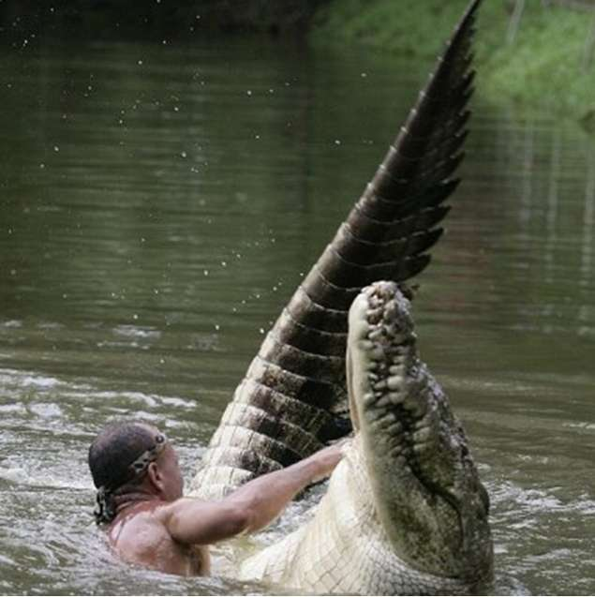
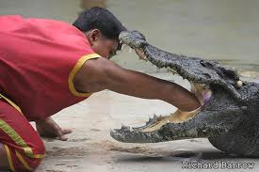
Should anyone obey the Pope and lay a hand on the crocodile? How long would we live if we touched a crocodile? Invitation to all scholars backing the NAB and NIV to show or clarify this for us!

Slide 43
AV1611 Proverbs 30:18 There be three things which are too wonderfull for me; yea foure, which I know not:
NAB Proverbs 30:18
Three things are too wonderful for me, yes, four I cannot understand:
NIV Proverbs 30:18 There are three things that are too amazing for me, four that I do not understand:

Slide 44
What the holy Ghost taught me:
The four things in “Proverbs 30:19 The way of an Eagle in the ayre; the way of a serpent vpon a rocke; the the way of a ship in the midst of the sea; and the way of a man with a maid. 20 Such is the way of an adulterous woman: she eateth, and wipeth her mouth, and saith, I haue done no wickednesse.” are a reference to Babylon and her unsaved children that Jesus knows not because he never knew them (not born again.)
The God of false scriptures does not understand! Who then can help us if God does not understand?
Mat 7:23 And then wil I professe vnto them, I neuer knew you: Depart from me, ye that worke iniquity.

Slide 45
AV1611 Prov 23:31 Looke not thou vpon the wine when it is red, when it giueth his colour in the cup, when it moueth it selfe aright. (See Job 40:17, Eze 17:4, and 2 Pet 1:21)
NAB Proverbs 23:31
Do not look on the wine when it is red, when it sparkles in the cup. It goes down smoothly,
NIV Proverbs 23:31 Do not gaze at wine when it is red,
when it sparkles in the cup, when it goes down smoothly!

Slide 46
What the holy Ghost taught me:
Psalm 75:8 For in the hand of the Lord there is a cup, and the wine is red: it is full of mixture, and he powreth out of the same: but the dregges thereof all the wicked of the earth shall wring them out, and drinke them.
Jer 51:7 Babylon hath beene a golden cup in the Lords hand, that made all the earth drunken: the nations haue drunken of her wine, therefore the nations are mad.
The image of the beast (Solomon’s Book of Wisdom) will make the earth drunk.
Rev 13:15And he had power to giue life vnto the Image of the beast, that the Image of the beast should both speake, and cause that as many as would not worship the Image of the beast, should be killed.

Slide 47
AV1611 Dan 2:37 Thou, O King, art a king of Kings: for the God of heauen hath giuen thee a kingdome, power, and strength, and glory.
NAB Dan 2:37 You, O king, are the king of kings; to you the God of heaven has given dominion and strength, power and glory;
NIV Dan 2:37 Your Majesty, you are the king of kings. The God of heaven has given you dominion and power and might and glory;

Slide 48
What the holy Ghost taught me:
Satan/Lucifer (A.K.A. the King of Babylon) wants to be like the most high (Isaiah 14:14, Ezra 7:12) and calls himself the king of kings. Jesus says that he is the King of kings (1 Tim 6:15, Rev 17:14, Rev 19:16) Satan teaches is his lamps (Job 41:19, Rev 8:10) that he is God.
Isaiah 14:14 …I wil bee like the most High.
Rev 17:14 These shal make warre with the Lambe, and the Lambe shal ouercome them: For he is Lord of Lords, and King of kings, and they that are with him, are called, & chosen, and faithfull.

Slide 49
AV1611 Gen 3:5 For God doeth know, that in the day ye eate thereof, then your eyes shalbee opened: and yee shall bee as Gods, knowing good and euill.
RSV Catholic Gen 3:5 For God knows that when you eat of it your eyes will be opened, and you will be like God, knowing good and evil.
NAB Catholic Gen 3:5 God knows well that when you eat of it your eyes will be opened and you will be like gods, who know* good and evil.” note: Like gods, who know: or “like God who knows.”
NIV Gen 3:5 For God knows that when you eat from it your eyes will be opened, and you will be like God, knowing good and evil.”

Slide 50
What the holy Ghost taught me:
Serpents (Satan’s) Lie
Genesis 3:5 (Where our problems began)
1611-“For God doeth know, that in the day ye eate thereof, then your eyes shalbee opened: and yee shall bee as Gods, knowing good and euill.” This was changed decades later to read: For God doth know that in the day ye eat thereof, then your eyes shall be opened, and ye shall be as gods, knowing good and evil.
God-Most High
Gods-Deity (other than Most High) imagined by a creation (Gen 3:5, Ex 20:3, 1 Sam 4:8)
gods-creation (man, angels, idols) Psalm 82:6, John 10:34
*Satan exalted Adam and Eve as Deities, not God or creations.
*God said that Adam and Eve became as Him to know good and evil

Slide 51
What the holy Ghost taught me:
Satan/Lucifer (A.K.A. the King of Babylon) wants to be like the most high (Isaiah 14:14, Ezra 7:12) and testifies that he is the messenger of truth that the woman should have listened to. God says there is no truth in the father of lies.
John 8:44 Ye are of your father the deuill, and the lusts of your father ye will doe: hee was a murtherer from the beginning, and abode not in the trueth, because there is no truth in him. When he speaketh a lie, he speaketh of his owne: for he is a liar, and the father of it.
Gen 3:22 And the LORD God said, Behold, the man is become as one of vs, to know good & euill. And now lest hee put foorth his hand, and take also of the tree of life, and eate and liue for euer:
John 10:34 Iesus answered them, Is it not written in your law, I said, ye are gods?

Slide 52
God testifies about the king of Tyrus (Babylon):
AV1611 Ezekiel 28:14 Thou art the annointed Cherub that couereth:…
NAB Ezekiel 28:14 With a cherub I placed you;
NIV Ezekiel 28:14 You were anointed as a guardian cherub,
for so I ordained you.

Slide 53
What the holy Ghost taught me:
Satan/Lucifer (A.K.A. the King of Babylon) wants us to believe he is not here on earth to deceive everyone. Apparently, according to Lucifer in his lamps, the King of Tyrus was a historic figure only and not a spiritual testimony of himself.

Slide 54
AV1611 Romans 6:22 But now being made free from sinne, and become seruants to God…
NAB Romans 6:22 But now that you have been freed from sin and have become slaves of God…
NIV Romans 6:22 But now that you have been set free from sin and have become slaves of God,…

Slide 55
What the holy Ghost taught me:
God tells us that Babylon has slaves in her merchandise (false scriptures.)
Rev 18:13 …and slaues, and soules of men.
Jesus frees people, they are servants with free will, not slaves.
1 Peter 2:16 As free, and not vsing your libertie for a cloake of maliciousnesse, but as the seruants of God.

Slide 56
AV1611 2 Tim 2:15 Studie to shewe thy selfe approued vnto God, a workman that needeth not to be ashamed, rightly diuiding the word of trueth. Titus 3:10 A man that is an heretike, after the first and second admonition, reiect:
NAB 2 Tim 2:15 Be eager to present yourself as acceptable to God, a workman who causes no disgrace, imparting the word of truth without deviation.^{m RSV-Catholic} Titus 3:10 As for a man who is factious, after admonishing him once or twice, have nothing more to do with him.
NIV 2 Tim 2:15 Do your best to present yourself to God as one approved, a worker who does not need to be ashamed and who correctly handles the word of truth. Titus 3:10 Warn a divisive person once, and then warn them a second time. After that, have nothing to do with them.

Slide 57
What the holy Ghost taught me:
Jesus came to bring division over his Word (Sword Rev 2:16, 19:15.) Many Corrupt the Word (2 Cor 2:17, Rev 18:23-24)
Luke 12:51 Suppose yee that I am come to giue peace on earth? I tell you, Nay, but rather diuision.
Mat 10:34 Thinke not that I am come to send peace on earth: I came not to send peace, but a sword.
John 7:43 So there was diuision among the people because of him.

Slide 58
AV1611 Matthew 6:7 But when yee pray, vse not vaine repetitions, as the heathen doe. For they thinke that they shall be heard for their much speaking.
NAB Matthew 6:7 In praying, do not babble like the pagans, who think that they will be heard because of their many words.*
NIV Matthew 6:7 And when you pray, do not keep on babbling like pagans, for they think they will be heard because of their many words.

Slide 59
What the holy Ghost taught me:
Jesus counsels against repetitive prayers. This means that Babylonian heathens pray rosaries which are very repetitious.
Babylon removes this counsel from her lamps/merchandise. This clears the way for rosaries and other meaningless vain and repetitive prayers.

Slide 60
AV1611 2 Samuel 21:19 And there was againe a battell in Gob, with the Philistines, where Elhanan the sonne of Iaare-Oregim a Bethlehemite, slewe the brother of Goliath the Gittite, the staffe of whose speare was like a weauers beame.
NAB 2 Samuel 21:19 There was another battle with the Philistines, in Gob, and Elhanan, son of Jair from Bethlehem, killed Goliath of Gath, whose spear shaft was like a weaver’s beam.
NIV 2 Samuel 21:19 In another battle with the Philistines at Gob, Elhanan son of Jaare-Oregim^{[a]} the Bethlehemite killed Goliath^{[b]} the Gittite, who had a spear with a shaft like a weaver’s rod.
Footnotes:a)Or son of Jair the weaver b) Hebrew and Septuagint; 1 Chron. 20:5 son of Jair killed Lahmi the brother of Goliath (NIV 1984 Version)

Slide 61
What the holy Ghost taught me:
*Babylon is confused in their corrupted Septuagint (70) MSS (see abominations in Ezekiel 8) Douay Rheims from Latin said struck not slew.
2 Kings 21:19 There was also a third battle in Gob against the Philistines, in the which Adeodatus the son of the Forest a broderer the Bethlehemite struck Goliath the Getheite, the shaft of whose spear was as it were a weavers beam.
1 Samuel 17:51 Therefore Dauid ran and stood vpon the Philistine, and tooke his sword, and drewe it out of the sheath thereof, and slew him, and cut off his head therewith. And when the Philistines sawe their champion was dead, they fled.
1 Sam 21:8-9 And Dauid said vnto Ahimelech, And is there not here vnder thine hand speare or sword? for I haue neither brought my sword nor my weapons with mee, because the kings businesse required haste. 9 And the Priest said, The sword of Goliath the Philistine, whome thou slewest in the valley of Elah,

Slide 62
AV1611 Mark 1:2 As it is written in the Prophets, Behold, I send my messenger before thy face, which shall prepare thy way before thee. Isaiah 40:3 The voyce of him that cryeth in the wildernesse, Prepare yee the way of the Lord, make straight in the desert a high way for our God.
NAB Mark 1:2 As it is written in Isaiah the prophet:… ^{b footnote b} [1:2] Mal 3:1.
NIV Mark 1:2 It is written in Isaiah the prophet:…
footnote b) Mal. 3:1

Slide 63
What the holy Ghost taught me:
What is written in Isaiah is also written in Malachi, Matthew, Mark, and Luke. Jesus testifies through a multitude of prophets. Proverbs 11:14, Psalm 119:24. Devil does not want to reveal this so Pope can operate the Mother of Cults/witchcrafts.
Malachi 3:1 Beholde, I will send my messenger, and he shal prepare the way before mee:
Mat 11:10 For this is he of whom it is written, Behold, I send my messenger before thy face, which shall prepare thy way before thee.
Luke 7:27 This is he of whome it is written, Behold, I send my messenger before thy face, which shall prepare thy way before thee.

Slide 64
AV1611 Matthew 1:25 And knewe her not, till shee had brought forth her first borne sonne, and he called his name Iesus.
NAB Matthew 1:25 He had no relations with her until she bore a son,* and he named him Jesus. Note [1:25] Until she bore a son: the evangelist is concerned to emphasize that Joseph was not responsible for the conception of Jesus. The Greek word translated “until” does not imply normal marital conduct after Jesus’ birth, nor does it exclude it.
NIV Matthew 1:25 But he did not consummate their marriage until she gave birth to a son. And he gave him the name Jesus.
http://es.catholic.net/sacerdotes/430/996/articulo.php?id=19021
In declaring Mary’s perpetual virginity, the Church not only affirms that our Blessed Mother is biologically a virgin before Jesus’ birth, during his birth and afterwards, but also that she dedicated her entire life to serving the Lord with total moral integrity and perfect chastity.

Slide 65
What the holy Ghost taught me:
Mark 6:3 Is not this the carpenter, the sonne of Mary, the brother of Iames and Ioses, and of Iuda, and Simon? And are not his sisters heere with vs? And they were offended at him.
1 John 5:8 And there are three that beare witnesse in earth, the Spirit, and the Water, and the Blood, and these three agree in one.
Luke 2:24 And to offer a sacrifice according to that which is said in the Law of the Lord, a paire of turtle doues, or two yong pigeons. (see Leviticus 12)
1 Cor 14:32-33 And the spirits of the Prophets are subiect to the Prophets. 33 For God is not the authour of confusion, but of peace, as in all Churches of the Saints.

Slide 66
AV1611 Matthew 17:21 Howbeit, this kind goeth not out, but by prayer and fasting. Acts 8:37 And Philip said, If thou beleeuest with all thine heart, thou mayest. And he answered, and said, I beleeue that Iesus Christ is the Sonne of God. Mark 11:26 But if you doe not forgiue, neither will your Father which is in heauen, forgiue your trespasses. Matthew 23:14 Woe vnto you Scribes and Pharisees, hypocrites; for yee deuoure widowes houses, and for a pretence make long prayer; therefore ye shall receiue the greater damnation. Matthew 18:11 For the sonne of man is come to saue that which was lost.
NAB Not included, Douay Rheims includes but Vatican changes mind after Tischendorf meets with Pope and Aleph LXX discovered in 1800’s
NIV Not included (LXX does not, see note above on Tischendorf and Pope)

Slide 67
What the holy Ghost taught me:
Rev 18:23 …for by thy sorceries were all nations deceiued.
Rev 22:18 For I testifie vnto euery man that heareth the wordes of the prophesie of this booke, If any man shal adde vnto these things, God shall adde vnto him the plagues, that are written in this booke. 19And if any man shall take away from the wordes of the booke of this prophesie, God shal take away his part out of the booke of life, and out of the holy citie, and from the things which are written in this booke.
Proverbs 30:6 Adde thou not vnto his words, lest he reproue thee, and thou be found a lyar.
Deuteronony 4:2 Ye shall not adde vnto the word which I command you, neither shall you diminish ought from it, that ye may keepe the Commaundements of the Lord your God, which I command you.

Slide 68
AV1611 Ephesians 5:11 And haue no fellowship with the vnfruitfull workes of darkenesse, but rather reproue them.
NAB Ephesians 5:11 Take no part in the fruitless works of darkness; rather expose them,^{j}
NIV Ephesians 5:11 Have nothing to do with the fruitless deeds of darkness, but rather expose them.

Slide 69
What the holy Ghost taught me:
Christians do not expose Satan, we can only rebuke using God’s Word.
Jude 1:9 Yet Michael the Archangel, when contending with the deuill, he disputed about the body of Moses, durst not bring against him a railing accusation, but said, The Lord rebuke thee.
John 15:5 I am the vine, ye are the branches: He that abideth in me, and I in him, the same bringeth forth much fruit: for without me ye can doe nothing.

Slide 70
AV1611 Ephesians 5:1 Be ye therefore followers of God, as deare children.
NAB Ephesians 5:1 So be imitators of God,* as beloved children
NIV Ephesians 5:1 Be imitators of God, therefore, as dearly loved children (NIV 1984)

Slide 71
What the holy Ghost taught me:
Christians do not try to nor can they be like the most High. Lucifer wants to imitate God and offers council in his merchandise of gold, silver, and precious stones (false scriptures.)
Question asked in Isaiah 14:12 How art thou fallen from heauen, O Lucifer, sonne of the morning?...
Answer given in Isaiah 14:14 …I wil bee like the most High.
Rev 14:4 …These are they which follow the Lambe whithersoeuer hee goeth:…

Slide 72
Conclusion:
I am not a “KJV only” person as men define this term. First, I believe the AV1611 bible that I have is the inspired Word of God translated into English from the preserved Hebrew and Greek. My AV1611 is much different than a KJV (as men define KJV’s.) God taught me his Word and revealed it to me by the power of the holy Ghost. He beat me severely and I was close to death. I lived so I could testify to others. The fear is indescribable and overwhelming. I would have rather had hot oil poured on me continuously than the horror I felt. I am not embellishing at all. Fortunately, God placed me in a Church where the pastor is taught the same by the holy Ghost and not by the precepts of men. Vatican corruptions preserve hell for the lost.

